Slide 1
Linearized Slot Representation
 | A1+ |  | A2 + |  | C1 - |  | C2 - |  | B1+ |  | B2+ |  | A1- |  | A2 - |  | C1 + |  | C2 + |  | B1- |  | B2-
Stator
Stationary side
Rotating side
X
X
N
o
o
S
 | I+ |  | I+ |  | I+ |  | I+ |  | I+ |  | I+ |  | I- |  | I- |  | I- |  | I- |  | I- |  | I-
 | A1+ |  | A2 + |  | C1 - |  | C2 - |  | B1+ |  | B2+ |  | A1- |  | A2 - |  | C1 + |  | C2 + |  | B1- |  | B2-
2-pole Rotor
 | I+ |  | I+ |  | I+ |  | I- |  | I- |  | I- |  | I- |  | I- |  | I- |  | I- |  | I- |  | I-
 | A1+ |  | A2 + |  | C1 - |  | C2 - |  | B1+ |  | B2+ |  | A1- |  | A2 - |  | C1 + |  | C2 + |  | B1- |  | B2-
2-pole Rotor

Slide 2
Linearized Slot Representation
 | A+ |  | X + |  | C- |  | Z - |  | B+ |  | Y+ |  | A- |  | X - |  | C+ |  | Z + |  | B - |  | Y -
X
X
N
o
o
S
2-pole Rotor
 | I+ |  | I+ |  | I+ |  | I+ |  | I+ |  | I+ |  | I- |  | I- |  | I- |  | I- |  | I- |  | I-
 | I+ |  | I+ |  | I+ |  | I+ |  | I+ |  | I+ |  | I- |  | I- |  | I- |  | I- |  | I- |  | I-
4-pole Rotor

Slide 3
X
X
N
o
o
S
 | I+ |  | I+ |  | I+ |  | I+ |  | I+ |  | I+ |  | I- |  | I- |  | I- |  | I- |  | I- |  | I-
 | A1+ |  | A2 + |  | C1 - |  | C2 - |  | B1+ |  | B2+ |  | A1- |  | A2 - |  | C1 + |  | C2 + |  | B1- |  | B2-
2-pole Rotor
 | I+ |  | I+ |  | I+ |  | I- |  | I- |  | I- |  | I- |  | I- |  | I- |  | I- |  | I- |  | I-
 | A1+ |  | A2 + |  | C1 - |  | C2 - |  | B1+ |  | B2+ |  | A1- |  | A2 - |  | C1 + |  | C2 + |  | B1- |  | B2-
4-pole Rotor

Slide 4
X
X
N
o
o
S
 | I+ |  | I+ |  | I+ |  | I+ |  | I+ |  | I+ |  | I- |  | I- |  | I- |  | I- |  | I- |  | I-
 | A1+ |  | A2 + |  | C1 - |  | C2 - |  | B1+ |  | B2+ |  | A1- |  | A2 - |  | C1 + |  | C2 + |  | B1- |  | B2-
2-pole Rotor
 | I+ |  | I+ |  | I+ |  | I- |  | I- |  | I- |  | I- |  | I- |  | I- |  | I- |  | I- |  | I-
 | A1+ |  | A2 + |  | C1 - |  | C2 - |  | B1+ |  | B2+ |  | A1- |  | A2 - |  | C1 + |  | C2 + |  | B1- |  | B2-
4-pole Rotor

Slide 5
S
Linearized slot representation
 | A+ |  | C- |  | B+ |  | A- |  | C+ |  | B-
Stator
Stationary side
Harvesting coil
Rotating side
X
o
o
X
N
S
Rotor
Mutual inductances between stator windings and harvesting coil:
Phase A: Positive
Phase B: Positive
Phase C: Negative
They are rotation -independent if saturation ignored at this stage.

Slide 6
Stator Winding Utilization : Basic EESM- 2 Pole
Linearized slot representation
 | A+ |  | C- |  | B+ |  | A- |  | C+ |  | B-
Stator
Stationary side
Harvesting coil
Rotating side
X
o
o
X
N
S
Rotor
Mutual inductances between stator windings and harvesting coil:
Phase A: Positive
Phase B: Positive
Phase C: Negative
They are rotation -independent if saturation ignored at this stage.

Slide 7
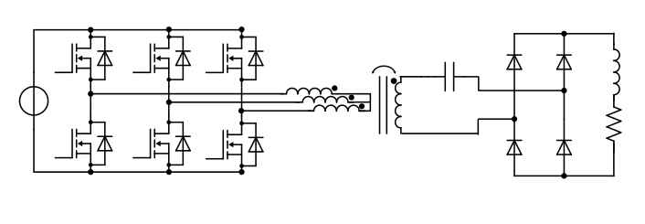

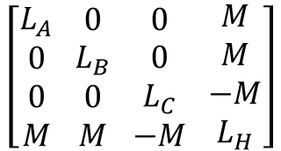


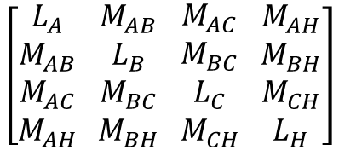






Tuned Harvesting Coil
$$Coupling$$
$$L_{A}$$
$$L_{F}$$
$$V_{DC}$$
$$L_{H}$$
$$C_{H}$$
$$L_{B}$$
$$L_{C}$$
$$R_{F}$$
$$\left[\begin{aligned}L_{A} \\ M_{AB} \\ M_{AC} \\ M_{AH}\end{aligned} \begin{aligned}M_{AB} \\ L_{B} \\ M_{BC} \\ M_{BH}\end{aligned} \begin{aligned}M_{AC} \\ M_{BC} \\ L_{C} \\ M_{CH}\end{aligned} \begin{aligned}M_{AH} \\ M_{BH} \\ M_{CH} \\ L_{H}\end{aligned}\right]$$
Simplified
Inductance Matrix
$$\left[\begin{aligned}L_{A} \\ 0 \\ 0 \\ M\end{aligned} \begin{aligned}0 \\ L_{B} \\ 0 \\ M\end{aligned} \begin{aligned}0 \\ 0 \\ L_{C} \\ −M\end{aligned} \begin{aligned}M \\ M \\ −M \\ L_{H}\end{aligned}\right]$$
Inductance Matrix

Slide 8
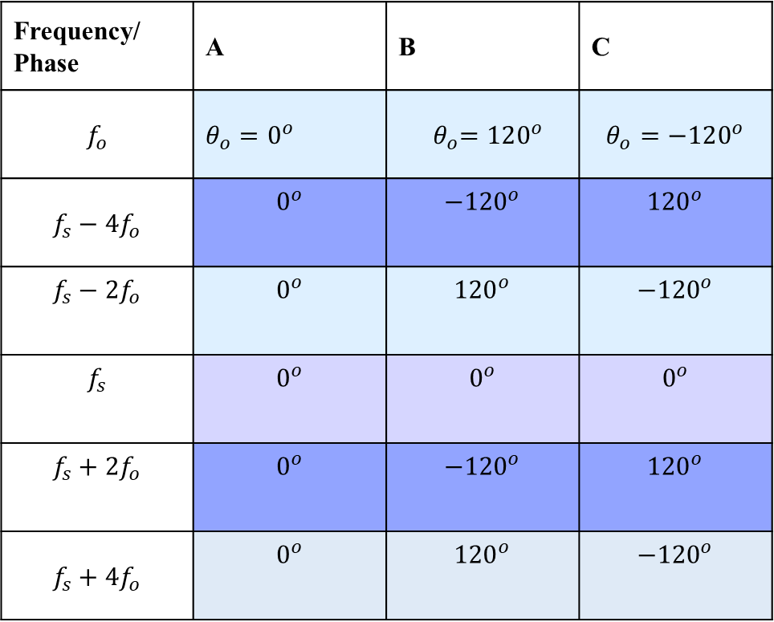
Switching Harmonics- Sequences
Frequency/ Phase | A | B | C
$$f_{o}$$ | $θ_{o}=0^{o}$ | $${ θ}_{o}=120^{o}$$ | $$θ_{o}=−120^{o}$$
$$f_{s}−4f_{o}$$ | $$0^{o}$$ | $${−120}^{o}$$ | $${120}^{o}$$
$$f_{s}−2f_{o}$$ | $$0^{o}$$ | $${120}^{o}$$ | $${−120}^{o}$$
$$f_{s}$$ | $$0^{o}$$ | $$0^{o}$$ | $$0^{o}$$
$$f_{s}+2f_{o}$$ | $$0^{o}$$ | $${−120}^{o}$$ | $${120}^{o}$$
$$f_{s}+4f_{o}$$ | $$0^{o}$$ | $${120}^{o}$$ | $${−120}^{o}$$

Slide 9





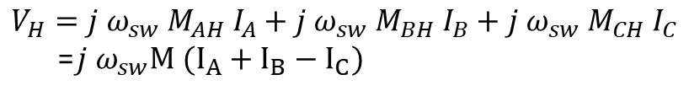


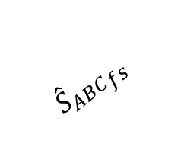

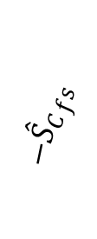
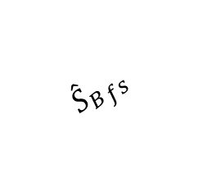

The Induced Superimposed Voltage
$$V_{H}=j ω_{sw} M_{AH} I_{A}+j ω_{sw} M_{BH} I_{B}+j ω_{sw} M_{CH} I_{C}$$
=$j ω_{sw}M (I_{A}+I_{B}−I_{C})$
$$I_{A}, I_{B}, I_{C}$$
Related switching functions, $S_{A}, S_{B}, S_{C}$
$| {{\hat{S}}_{B}}_{fs }+{{\hat{S}}_{C}}_{fs }|$
$$α=φ_{C−B}−φ_{C−A}$$
$| {{\hat{S}}_{B}}_{fs }$-${{\hat{S}}_{C}}_{fs }|$
$$β=−φ_{C−C}−φ_{C−B}$$
$$β$$
$${{\hat{S}}_{ABC}}_{fs }$$
$${{−\hat{S}}_{C}}_{fs }$$
$${{\hat{S}}_{B}}_{fs }$$
$$φ$$
$$α$$
$${{\hat{S}}_{A}}_{fs }$$
(a)
(b)
(c)

Slide 10






The Controllable Region of the Superimposed Voltage - SPWM
$$m_{a}=0$$
$$m_{a}=0.25$$
$$m_{a}=0.50$$
$$m_{a}=0.75$$
$$m_{a}=0.80$$
$$m_{a}=1$$

Slide 11




The Controllable Region of the Superimposed Voltage - SVPWM
$$m_{a}=0.50$$
$$m_{a}=0$$
$$m_{a}=0.25$$
$$m_{a}=0.75$$
$$m_{a}=1$$
$m_{a}=1$.1

Slide 12
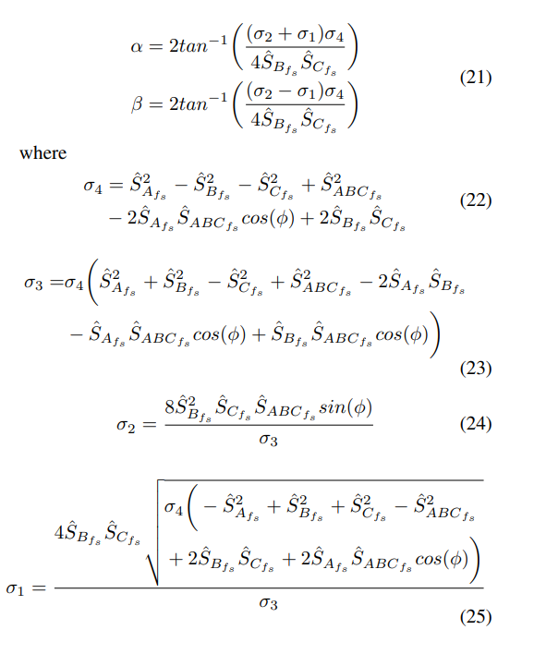
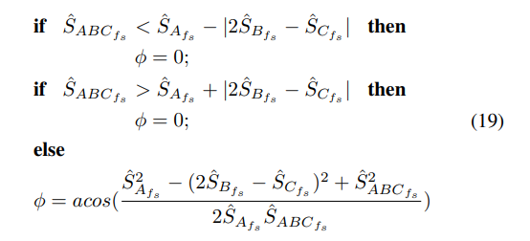
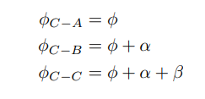
Challenge- Calculation Burden (Robotic Arm Kinematics)
Notes:
The WPT system is connected between phase-A and phase B.
By carrier phase shift to phase B, we achieve this contour of the magnitude of the switching frequency.
We can observe that we can have a constant gain for any modulation.
The constant gain is between 0.25 and 0.45 over a DC-link voltage.
The control diagram is shown.
We adjust the carrier phase shift according to modulation to control the WPT power.

Slide 13
References
Simultaneous Information/
Power Transfer
Selective
Power Transfer
Slip-Ring Applications
Single-Stage
Power Transfers
Concurrent Power Transfer
Simultaneous Wireless Information and Power Transfer (SWIPT): Recent Advances and Future Challenges (2018)
Integrated Resonant Structure for Simultaneous Wireless Power Transfer and Data Telemetry(2012)
A Simultaneous Wireless Power and Data Transmission Method for Multi-Output WPT Systems: Analysis, Design, and Experimental Verification (2020)
Selective Omnidirectional Magnetic Resonant Coupling Wireless Power Transfer With Multiple-Receiver System(2018)
Design and Analysis of Wireless Switched Reluctance Motor Drives(2019)
Frequency Splitting-Based Wireless Power Transfer and Simultaneous Propulsion Generation to Multiple Micro-Robots(2018)
Comparative Analysis of Frequency-Selective Wireless Power Transfer for Multiple-Rx Systems(2020)
A Frequency-Selective EMI Reduction Method for Tightly Coupled Wireless Power Transfer Systems Using Resonant Frequency Control of a Shielding Coil in Smartphone Application(2020)
Selective Wireless Power Transfer for Smart Power Distribution in a Miniature-Sized Multiple-Receiver System(2016)
A Multifrequency Superposition Methodology to Achieve High Efficiency and Targeted Power Distribution for a Multiload MCRWPT System(2018)
Cross Interference Minimization and Simultaneous Wireless Power Transfer to Multiple Frequency Loads Using Frequency Bifurcation Approach
A Primary-Side Control Method of Wireless Power Transfer for Motor Electric Excitation(2019)
Wireless DC Motor Drives with Selectability and Controllability(2017)
An Airborne Radar Power Supply With Contactless Transfer of Energy—Part I: Rotating Transformer (2007)
Aerodynamic Fluid Bearings for Translational and Rotating Capacitors in Noncontact Capacitive Power Transfer Systems(2014)
Synchronous Generator Brushless Field Excitation and Voltage Regulation via Capacitive Coupling Through Journal Bearings(2017)
Operation of an Electrical Excited Synchronous Machine by Contactless Energy Transfer to the Rotor(2018)
A Rotation-Lightweight Wireless Power Transfer System for Solar Wing Driving(2019)
Wireless Power Transfer for Smart Industrial and Home Applications(2019)
Use of the Rotating Rectifier Board as a Capacitive Power Coupler for Brushless Wound Field Synchronous Machines(2022)
A High-Efficiency GaN-Based Single-Stage 6.78 MHz Transmitter for Wireless Power Transfer Applications(2019)
Cooperative Integration of RF Energy Harvesting and Dedicated WPT for Wireless Sensor Networks(2019)
A Three-Phase Single-Stage AC–DC Wireless-Power-Transfer Converter With Power Factor Correction and Bus Voltage Control(2020)
Individually Regulated Multiple-Output WPT System With a Single PWM and Single Transformer (2020)
Multifrequency Inductive Power Transfer(2014)
Wireless Power Transfer With Concurrent 200-kHz and 6.78-MHz Operation in a Single-Transmitter Device (2016)
Gan-Based Dual-Mode Wireless Power Transfer Using Multifrequency Programmed Pulse Width Modulation (2017)
A Multifrequency Superposition Methodology to Achieve High Efficiency and Targeted Power Distribution for a Multiload MCRWPT System (2018)
Cross Interference Minimization and Simultaneous Wireless Power Transfer to Multiple Frequency Loads Using Frequency Bifurcation Approach(2019)
A Gallium Nitride (GaN)-Based Single-Inductor Multiple-Output (SIMO) Inverter With Multi-Frequency AC Outputs (2019)
Single-Inductor Multiple-Output (SIMO) Buck Hybrid Converter for Simultaneous Wireless and Wired Power Transfer(2020)
Generalized methodology to generate, amplify and compensate multi-frequency power for a single-inverter-based MF-MR-S-WPT system (2020)
Concurrent Wireless Power Transfer to Multiple Receivers With Additional Resonant Frequencies and Reduced Power Switches (2020)
Multifrequency and Multiload MCR-WPT System Using Hybrid Modulation Waves SPWM Control Method (2021)
Multi-Frequency Multi-Amplitude Superposition Modulation Method With Phase Shift Optimization for Single Inverter of Wireless Power Transfer System (2021)
Design and Control of a Decoupled Multichannel Wireless Power Transfer System Based on Multilevel Inverters (2022)
A Dual-Frequency Three-Dimensional WPT System with Directional Power Transfer Capability at Two Separately Regulated Outputs (2022)

Slide 15

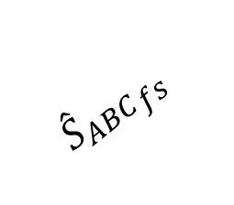

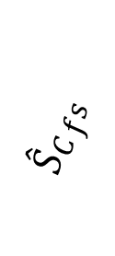





$$β$$
$${{\hat{S}}_{C}}_{fs }$$
$${{\hat{S}}_{ABC}}_{fs }$$
$${{\hat{S}}_{B}}_{fs }$$
$$φ$$
$$α$$
$| {{\hat{S}}_{B}}_{fs}+{{\hat{S}}_{C}}_{fs }|$
$${{\hat{S}}_{A}}_{fs }$$
(a)
$| {{\hat{S}}_{B}}_{fs}$-${{\hat{S}}_{C}}_{fs }|$
(a)
(b)

Slide 16





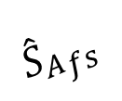


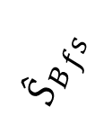





$$β$$
$${{\hat{S}}_{B}}_{fs }$$
$$α$$
$${{\hat{S}}_{C}}_{fs }$$
$${{\hat{S}}_{B}}_{fs }$$
$${{\hat{S}}_{A}}_{fs }$$
$${{\hat{S}}_{A}}_{fs }$$
$$α$$
$$φ$$
$$φ$$
$${{\hat{S}}_{ABC}}_{fs }$$
$${{\hat{S}}_{ABC}}_{fs }$$
(a)
(b)
$| {{\hat{S}}_{B}}_{fs}+{{\hat{S}}_{C}}_{fs }|$
$| {{\hat{S}}_{B}}_{fs}$-${{\hat{S}}_{C}}_{fs }|$
(a)
(b)

Slide 17
https://www.ew.tu-darmstadt.de/media/ew/rd/ew_vortraege/kurs_gec/gec_4.pdf

